Slide 1
Module 3
Data Link Layer
Flow control
Dr. S.L.JAYALAKSHMI,
VIT Chennai

Slide 2
Outline
Flow Control Mechanism
Stop and wait ARQ Protocol
Sliding Window protocol
Go - Back - N Protocol
Selective Repeat Protocol

Slide 3
Data link Layer
Error Control (Check Part I of Module III)
Error Control in the data link layer is a process of detecting and retransmitting the data which has been lost or corrupted during the transmission of data.
Flow Control
Flow control is the process of managing the rate of data transmission between two nodes to prevent a fast sender from overwhelming a slow receiver.

Slide 4
Flow Control
Process of managing the rate of data transmission between two nodes to prevent a fast sender from overwhelming a slow receiver.
Receiver has limited speed to process incoming data and a limited memory to store incoming data.
Receiver must inform the sender before the limits are reached and request that the transmitter to send fewer frames or stop temporarily.
When the rate of processing is often slower than the rate of transmission, receiver has a block of memory (buffer) for storing incoming data until they are processed.

Slide 5
Flow Control Mechanisms
There are three types of flow control mechanism
Stop-and-Wait ARQ (Automatic Repeat Request)
Stop-and-Wait ARQ - lost ACK frame
Stop-and-Wait - delayed ACK frame
Piggybacking
Sliding window Protocol
Go-Back-N ARQ
Go-Back-N ARQ - normal operation
Go-Back-N ARQ - lost frame
Go-Back-N ARQ - damaged/lost/delayed ACK
Selective-Repeat ARQ
Sender and receiver windows
Selective Repeat ARQ - lost frame

Slide 6
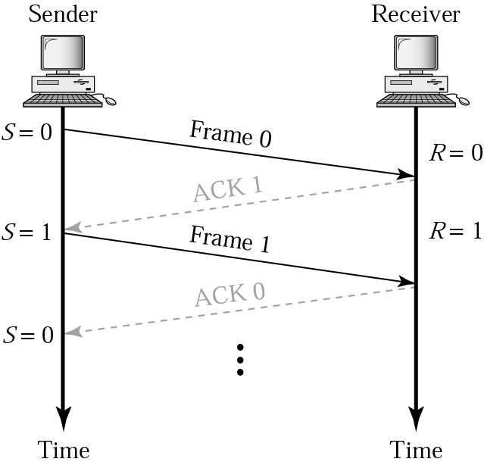
Stop-and-Wait ARQ
Sender keeps a copy of the last frame until it receives an acknowledgement.
Both data frames and acknowledgement (ACK) frames are numbered alternatively 0 and 1.
Sender has a control variable (S) that holds the number of the recently sent frame. (0 or 1)
Receiver has a control variable (R) that holds the number of the next frame expected (0 or 1).
Receiver send only positive ACK if the frame is intact.
ACK number always defines the number of the next expected frame

Slide 7
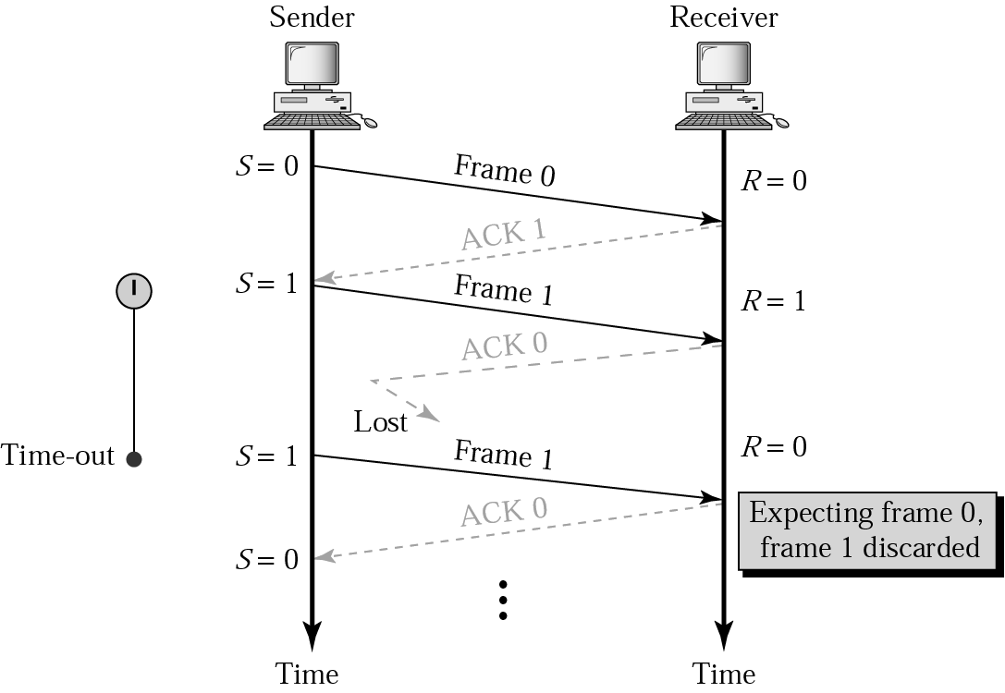
Stop-and-Wait, lost ACK frame
If the sender receives a damaged ACK, it discards it.
When the timer of the sender expires, the sender retransmits frame 1.
Receiver has already received frame 1 and expecting to receive frame 0 (R=0). Therefore it discards the second copy of frame 1.

Slide 8
Stop-and-Wait, delayed ACK frame
The ACK can be delayed at the receiver or due to some problem
It is received after the timer for frame 0 has expired.
Sender retransmitted a copy of frame 0. However, since R =0 which means receiver already has frame 0. Receiver discards the duplicate frame 0.
Sender receives 2 ACKs, it discards the second ACK.

Slide 9
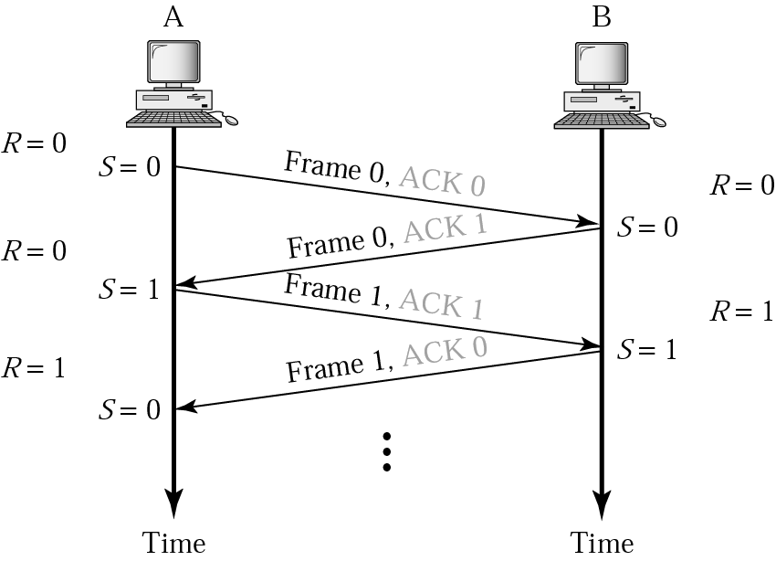
Piggybacking
A method to combine a data frame with ACK.
Station A and B both have data to send.
Instead of sending separately, station A sends a data frame that includes an ACK.
Station B does the same thing.
Piggybacking saves bandwidth.

Slide 10
Disadvantage of Stop-and-Wait
In stop-and-wait, at any point in time, there is only one frame that is sent and waiting to be acknowledged.
This is not a good use of transmission medium.
To improve efficiency, multiple frames should be in transition while waiting for ACK.
Two protocol use the above concept,
Go-Back-N ARQ
Selective Repeat ARQ

Slide 11
Go-Back-N ARQ
Sender can send up to W frames before worrying about ACKs.
Sender keeps the copy of these frames until the ACKs arrive.
This procedure requires additional features to be added to Stop-and-Wait ARQ.

Slide 12
Sequence Numbers
Frames from a sender are numbered sequentially.
We need to set a limit since we need to include the sequence number of each frame in the header.
If the header of the frame allows m bits, the sequence numbers range from 0 to 2^{m} – 1.
for m = 3, sequence numbers are: 1, 2, 3, 4, 5, 6, 7.
We can repeat the sequence number.
Sequence numbers are:
0, 1, 2, 3, 4, 5, 6, 7, 0, 1, 2, 3, 4, 5, 6, 7, 0, 1, …

Slide 13
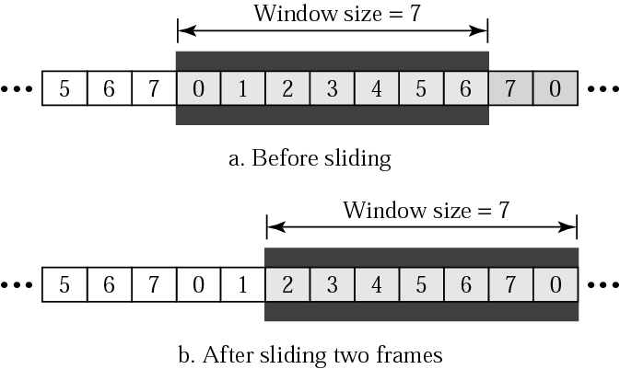
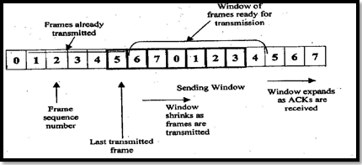
Sender Sliding Window
At the sending side, to hold the outstanding frames until they are acknowledged, the concept of a window is used.
The size of the window is at most 2^{m} -1 where m is the number of bits for the sequence number.
Size of the window can be variable.
The window slides to include new unsent frames when the correct ACKs are received

Slide 14
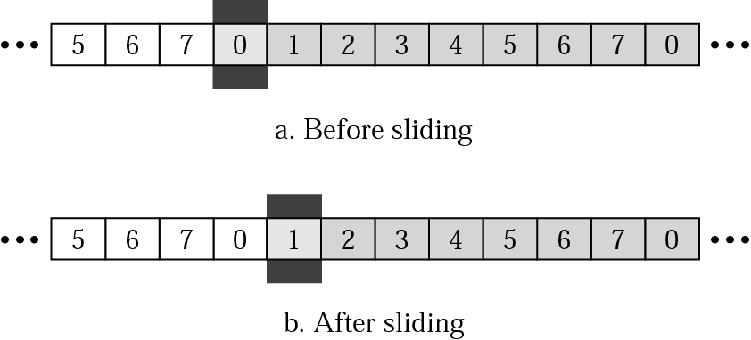
Receiver Sliding Window
Size of the window at the receiving site is always 1 in this protocol.
Receiver is always looking for a specific frame to arrive in a specific order.
Any frame arriving out of order is discarded and needs to be resent.
Receiver window slides as shown in fig. Receiver is waiting for frame 0 in part a.

Slide 15
Control Variables …
Sender has 3 variables: S, S_{F} and S_{L}
S holds the sequence number of recently sent frame
S_{F} holds the sequence number of the first frame
S_{L} holds the sequence number of the last frame
Receiver only has the one variable, R, that holds the sequence number of the frame it expects to receive. If the seq. no. is the same as the value of R, the frame is accepted, otherwise rejected.

Slide 16
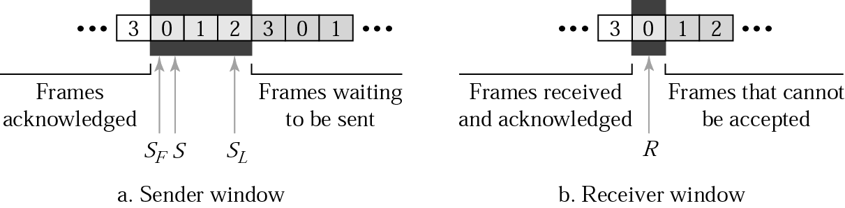
Control Variables

Slide 17
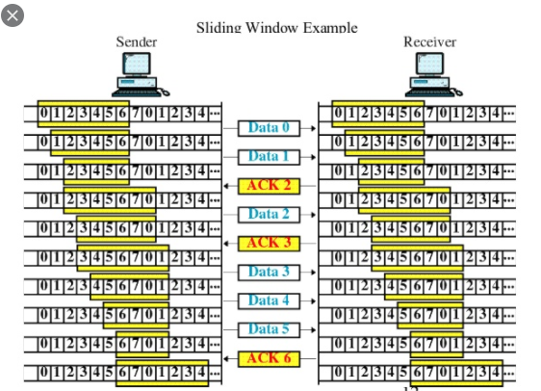

Slide 18
Acknowledgement
Receiver sends positive ACK if a frame is arrived safe and in order.
If the frames are damaged/out of order, receiver doesn’t respond and discard all subsequent frames until it receives the one it is expecting.
The silence of the receiver causes the timer of the unacknowledged frame to expire.
Then the sender resends all frames, beginning with the one with the expired timer.
For example, suppose the sender has sent frame 6, but the timer for frame 3 expires (i.e. frame 3 has not been acknowledged), then the sender goes back and sends frames 3, 4, 5, 6 again. Thus it is called Go-Back-N-ARQ
The receiver does not have to acknowledge each frame received, it can send one cumulative ACK for several frames.

Slide 19
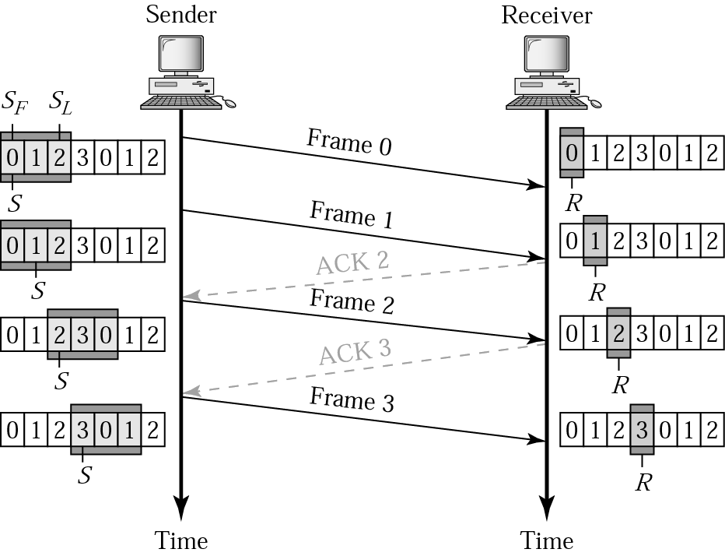
Go-Back-N ARQ, normal operation
The sender keeps track of the outstanding frames and updates the variables and windows as the ACKs arrive.

Slide 20
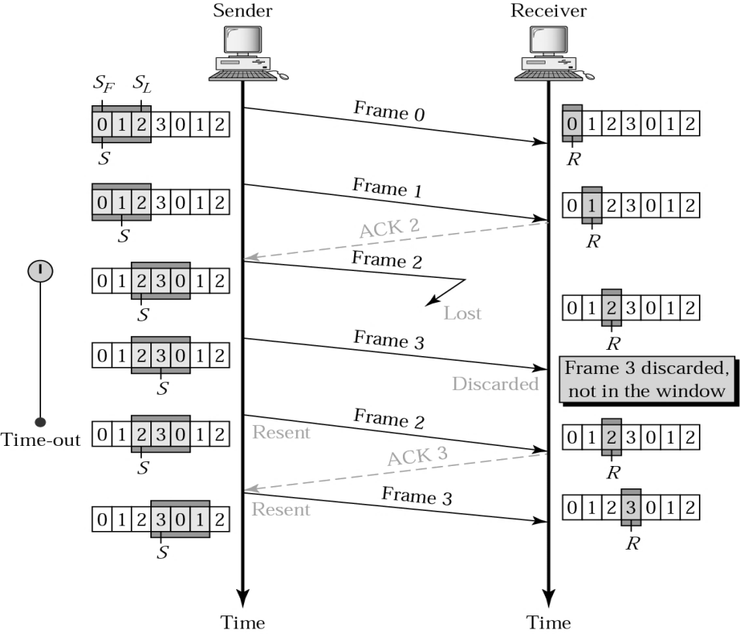
Go-Back-N ARQ, lost frame
Frame 2 is lost
When the receiver receives frame 3, it discards frame 3 as it is expecting frame 2 (according to window).
After the timer for frame 2 expires at the sender site, the sender sends frame 2 and 3. (go back to 2)

Slide 21
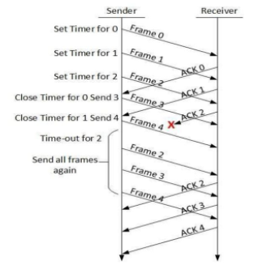
Go-Back-N ARQ, damaged/lost/delayed ACK
If an ACK is damaged/lost, we can have two situations:
If the next ACK arrives before the expiration of any timer, there is no need for retransmission of frames because ACKs are cumulative in this protocol.
If ACK1, ACK2, and ACK3 are lost, ACK4 covers them if it arrives before the timer expires.
If ACK4 arrives after time-out, the last frame and all the frames after that are resent.
Receiver never resends an ACK.
A delayed ACK also triggers the resending of frames.

Slide 22
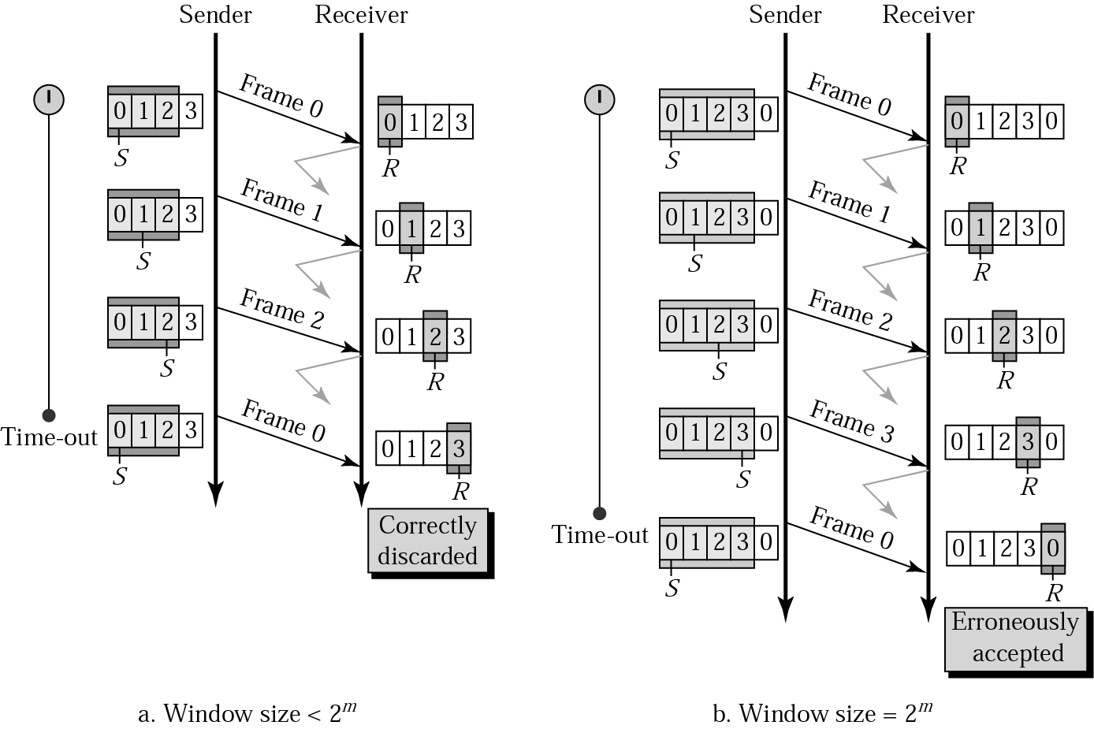
Go-Back-N ARQ, sender window size
Size of the sender window must be less than 2 ^{m}.
Size of the receiver is always 1.
If m = 2, window size = 2 ^{m} – 1 = 3.
Fig compares a window size of 3 and 4.

Slide 23
Selective Repeat ARQ, sender and receiver windows
Go-Back-N ARQ simplifies the process at the receiver site.
Receiver only keeps track of only one variable
There is no need to buffer out-of-order frames, they are simply discarded.
Go-Back-N ARQ protocol is inefficient for noisy link.
It bandwidth inefficient and slows down the transmission.
In Selective Repeat ARQ, only the damaged frame is resent.
More bandwidth efficient but more complex processing at receiver.
It defines a Negative ACK (NAK) to report the sequence number of a damaged frame before the timer expires.

Slide 24
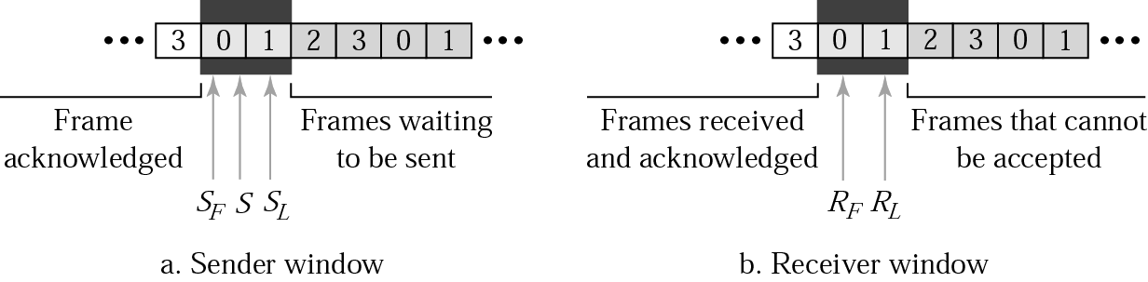

Slide 25
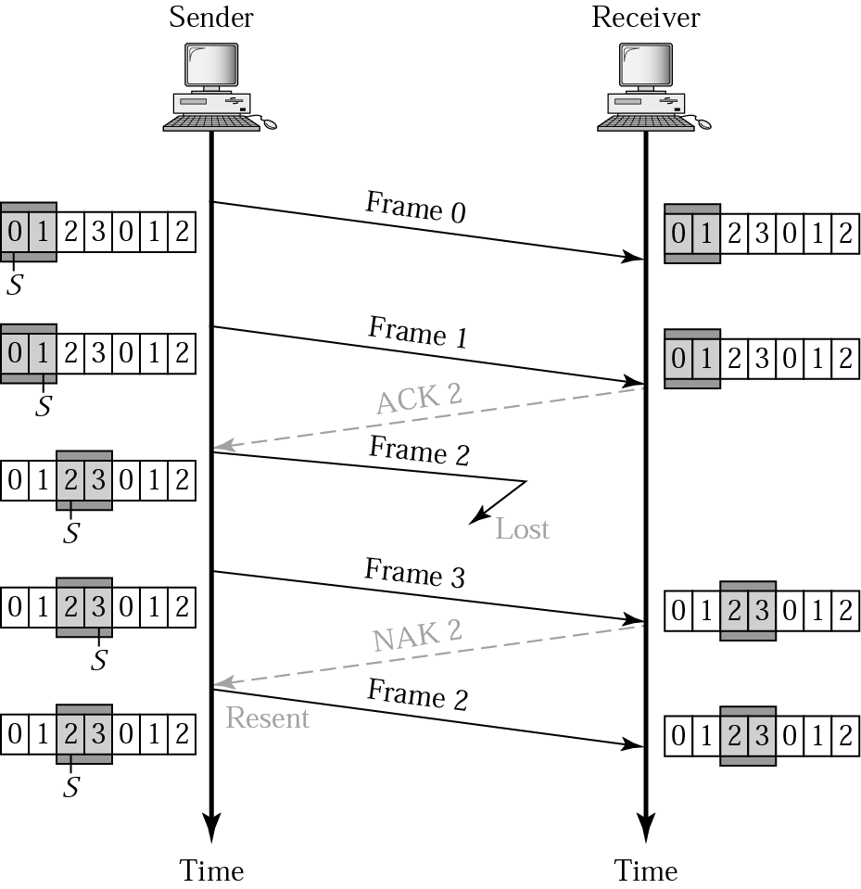
Selective Repeat ARQ - lost frame
Frames 0 and 1 are accepted when received because they are in the range specified by the receiver window. Same for frame 3.
Receiver sends a NAK2 to show that frame 2 has not been received and then sender resends only frame 2 and it is accepted as it is in the range of the window.

Slide 26
References
Computer Networks: A Systems Approach, Larry Peterson and Bruce Davie, 5th Ed, The Morgan Kaufmann Series, Elsevier, 2011.
Computer Networking: A Top-Down Approach Featuring the Internet, J. F. Kurose and K. W. Ross, 6th Ed., Pearson Education,2012.
Data Communications and Networking, Behrouz A. Forouzan, McGraw Hill Education, 5th Ed., 2012
TCP/IP Protocol Suite, Behrouz A. Forouzan, McGraw-Hill Education, 4 Ed., 2009
Data and Computer Communications, William Stallings, Pearson Education,10th Ed,2013.

